Slide 1
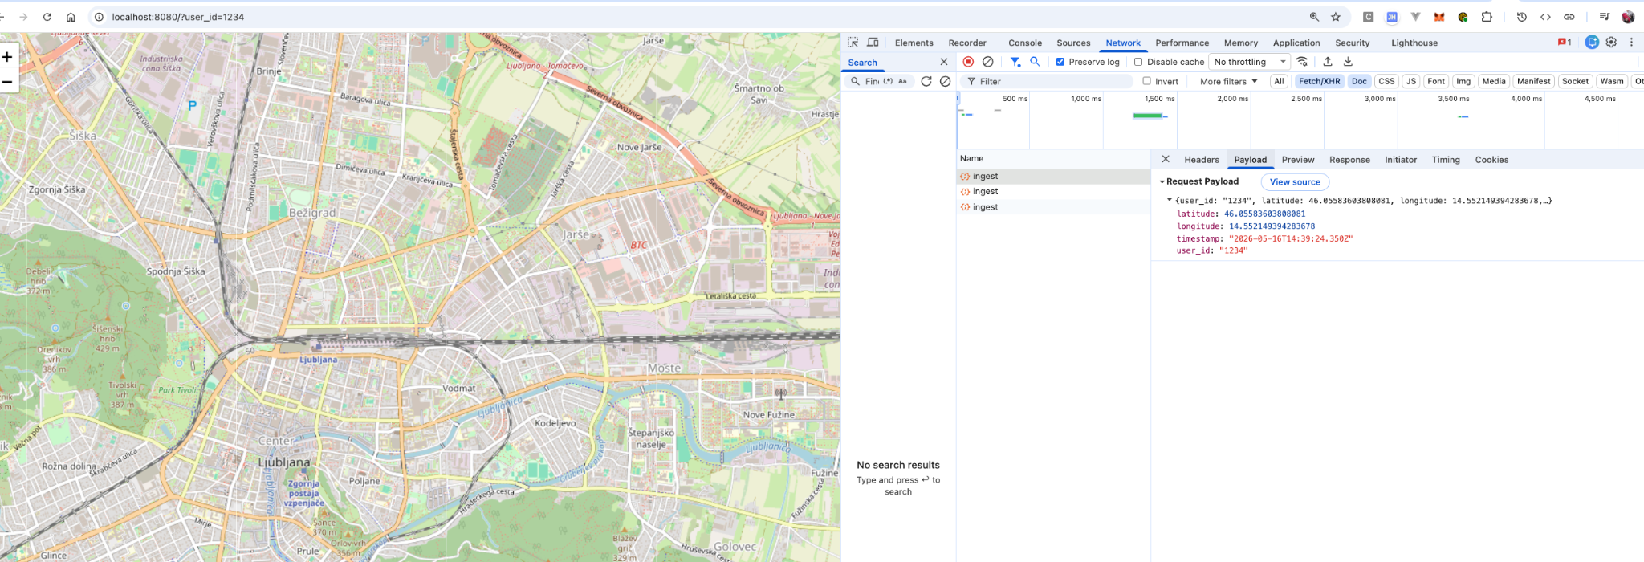
The Commute Crossings Rendezvous Network
This is your space for legal copy. State whether the information is confidential and how it's intended to be used.
Company Name
Date

Slide 2
The Commute Crossings Rendezvous Network is a specialized platform designed to simplify peer-to-peer exchanges by identifying overlapping travel patterns. By tracking daily transit routes, the system connects individuals whose paths naturally intersect to facilitate the trading of goods and services. This initiative aims to foster a sustainable economy by promoting the reuse of items over the acquisition of new products. The architecture includes a backend database to analyze location data and a frontend simulation interface utilizing map interactions. Ultimately, the service transforms routine travel into opportunities for community sharing and environmental conservation.

Slide 3
echo "=== Ingest points for user 1234 ==="
curl -s -X POST "$BASE/commutes/ingest" -H "Content-Type: application/json" \
-d '{"user_id":"1234","latitude":46.055,"longitude":14.505,"timestamp":"2026-05-16T08:00:00Z"}'
echo
curl -s -X POST "$BASE/commutes/ingest" -H "Content-Type: application/json" \
-d '{"user_id":"1234","latitude":46.060,"longitude":14.510,"timestamp":"2026-05-16T08:05:00Z"}'
echo
echo "=== Ingest points for user 666 ==="
curl -s -X POST "$BASE/commutes/ingest" -H "Content-Type: application/json" \
-d '{"user_id":"666","latitude":46.055,"longitude":14.505,"timestamp":"2026-05-16T17:00:00Z"}'
echo
curl -s -X POST "$BASE/commutes/ingest" -H "Content-Type: application/json" \
-d '{"user_id":"666","latitude":46.062,"longitude":14.508,"timestamp":"2026-05-16T17:05:00Z"}'
echo
echo "=== Check intersection ==="
curl -s -X POST "$BASE/commutes/intersections" -H "Content-Type: application/json" \
-d '{

Slide 4
=== Ingest points for user 1234 ===
{"status": "success", "id": 66}
{"status": "success", "id": 67}
=== Ingest points for user 666 ===
{"status": "success", "id": 68}
{"status": "success", "id": 69}
=== Check intersection ===
{"shared_cells": ["891e1216ba7ffff"]}

